Slide 1

New Media
Digital Campaign:
A Timeless Classic
in a
Modern World
Abraxas Business Communications Solutions

Slide 2
A Brief History of
Harley Davidson
Motorcycles
Notes:
Founded in 1903 by William Harley and Arthur Davidson, the Harley Davidson motorcycle manufacturing company was born and it's first motorcycle was introduced to the public. In the years following the company's inception, the pair, produced variety of motorcycles. As the company grew, the motorcycles is produced began to evolve in style and engine power. The Harley Davidson brand had grown so popular that the United States Army began using the company's two-wheeled vehicles during World War II, purchasing over 90,000 motorcycles from Harley Davidson (Frank, 2018). Over the last century, the Harley Davidson brand has become synonymous with the word motorcycle - and because of the company's reputation for such quality craftsmanship, people throughout the world recognize the brand as a premier manufacturer of the finest motorcycles on the road today.

Slide 3
• First started in 1905 • Founded by William Harley and Arthur Davidson • Used by US Army in World War II • Reputation for fine, quality craftsmanship • World renowned (Frank, 2018)

Slide 4

Image courtesy of https://www.nomadlogic.com/clients/harley-davidson-logo/

Slide 5
Old Meets New

Slide 6
• Understanding the audience • Motivate the audience • Demonstrate interest in audience concerns • Environmental and economic factors
(Robison, 2021)
Notes:
The median age of Harley Davidson motorcycle owners is 50 years old. It is apparent that there exists a need to reach younger riders and attract them to the Harley Davidson motorcycle brand. Who is the audience? The target audience is people ranging in age between 25 and 35. To reach this audience successful, it is important to understand their interests - what motivates or inspires them. One key factor is the audience's view on environmental issues. Younger people tend to be more concerned about the environment than past generations. 67 percent of people aged 18 to 29 and 49 percent of those 30 to 49 day global warming is real, man-made and a serious threat (Robison, 2021). A second motivating factor is cost efficiency. Ultimately, reaching the audience by expressing a concern for issues relevant to them will be the appropriate strategy for soliciting the desired response and attracting new and younger people to the Harley Davidson motorcycle brand.

Slide 7
Optimizing Communications
with the
Target Audience:
Messaging Channels
Notes:
To connect with an audience, it is necessary to understand what communication channels they can be more readily reached through,

Slide 8
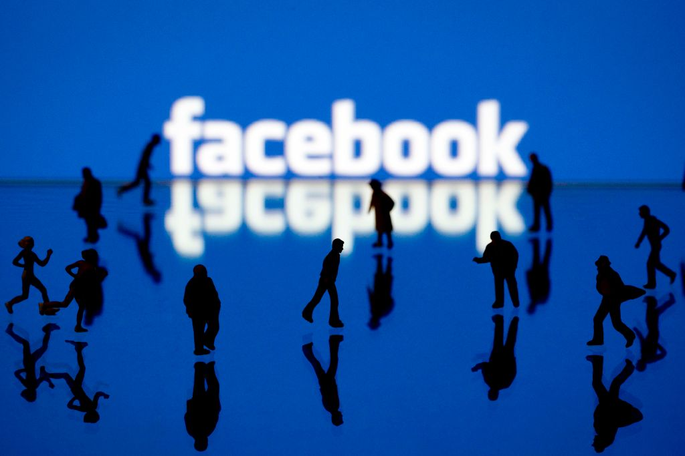
• Facebook
18 to 29: 70 percent
30 to 49: 77 percent
Women: 77 percent
Men: 61 percent
(Pewresearchcenter, 2022)
Image Courtesy of https://time.com/5633726/how-to-delete-facebook-data/
Notes:
According to the Pew Research Center, Facebook has a user rate of 70 percent among those 18 to 29 and a user rate of 77 percent among those 30 to 49 years old. 77 percent of women and 61 percent of men use Facebook.

Slide 9

• YouTube
18 to 29 - 95 percent
30 to 49 - 81 percent
Women - 80 percent
Men - 82 percent
(pewresearchcenter, 2022)
Image Courtesy of https://www.brandwatch.com/blog/youtube-stats/
Notes:
The Pew Research Center, YouTube has a 95 percent user rate among those 18 to 29 and an 81 percent user rate of those 30 to 49. Of the total number of users, 80 percent are women and 82 percent are men (pewresearchcenter.org, 2022).
. Because of the large number of users within n the target audience age range, it is believed that these platforms -YouTube and Facebook - will be the most effective channels for communicating with the target audience.

Slide 10
Messaging

Slide 11
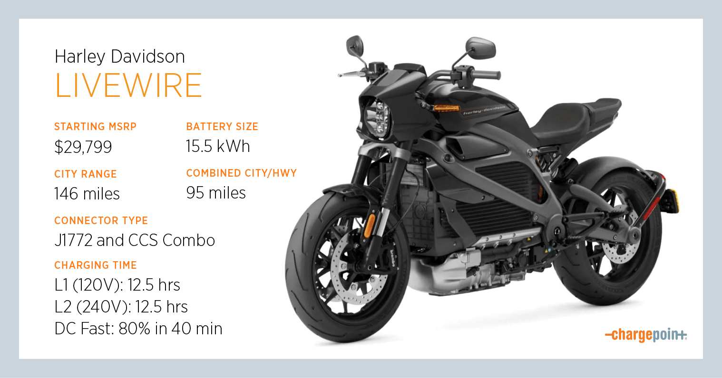
Tired of paying too much for gas?
Harley Davidson Motorcycles has just the solution you need. The Harley Davidson Livewire is a fully electric motorcycle that gets 165 mpc – and for just $29,799 can get you anywhere for less. Go green for less green! #savetheplanetsaveonfuel #harleylivewire
Image Courtesy of https://www.chargepoint.com/blog/everything-you-need-know-about-charging-harley-davidson-livewire
Notes:
Tired of paying too much for gas?Harley Davidson Motorcycles has just the solution you need. The Harley Davidson Livewire is a fully electric motorcycle that gets 165 mpc – and for just $29,799 can get you anywhere for less. Go green for less green! #savetheplanetsaveonfuel #harleylivewire

Slide 12
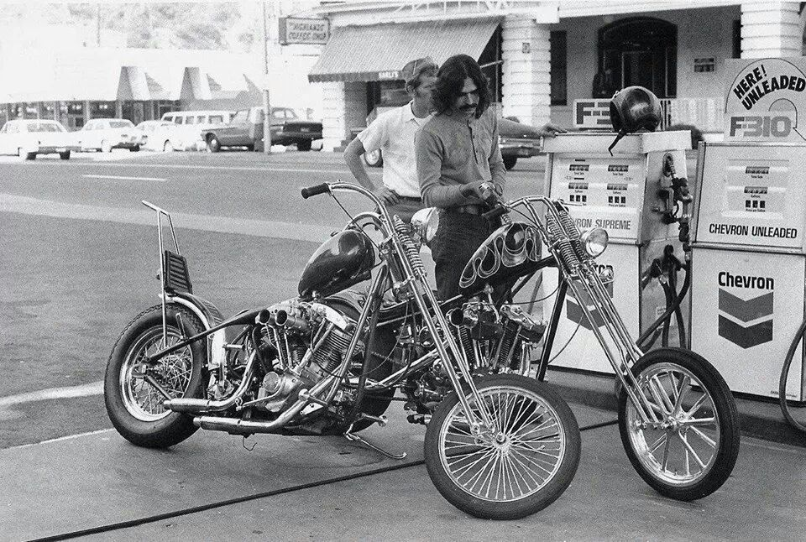
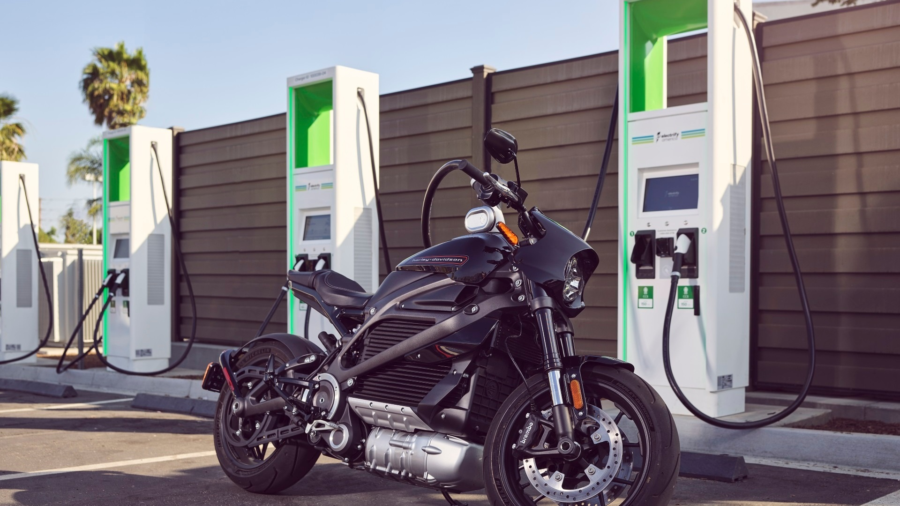
Not Your Father’s Harley
Image Courtesy of https://www.tropicarguadeloupe.fr/products.aspx?cname=70s+sportster+chopper&cid=5&xi=3&xc=25&pr=73.99
Image Courtesy of https://www.greencarreports.com/news/1123991_harley-davidson-gives-livewire-owners-free-charging-with-electrify-america
This isn't your dad's generation, and it’s definitely not his motorcycle. No, this is yours. It's your turn to celebrate freedom - to feel the wind in your face and miles of wide-open road in front of you. Harley Davidson Motorcycles offers a wide line of motorcycles to choose from. Come in and check our bikes out. We know we have a bike that'll match your personality - and who knows, maybe your next trip will take you across the country! #borntobewild #harleydavidson
Notes:
This isn't your dad's generation, and it’s definitely not his motorcycle. No, this is yours. It's your turn to celebrate freedom - to feel the wind in your face and miles of wide-open road in front of you. Harley Davidson Motorcycles offers a wide line of motorcycles to choose from. Come in and check our bikes out. We know we have a bike that'll match your personality - and who knows, maybe your next trip will take you across the country! #borntobewild #harleydavidson

Slide 13
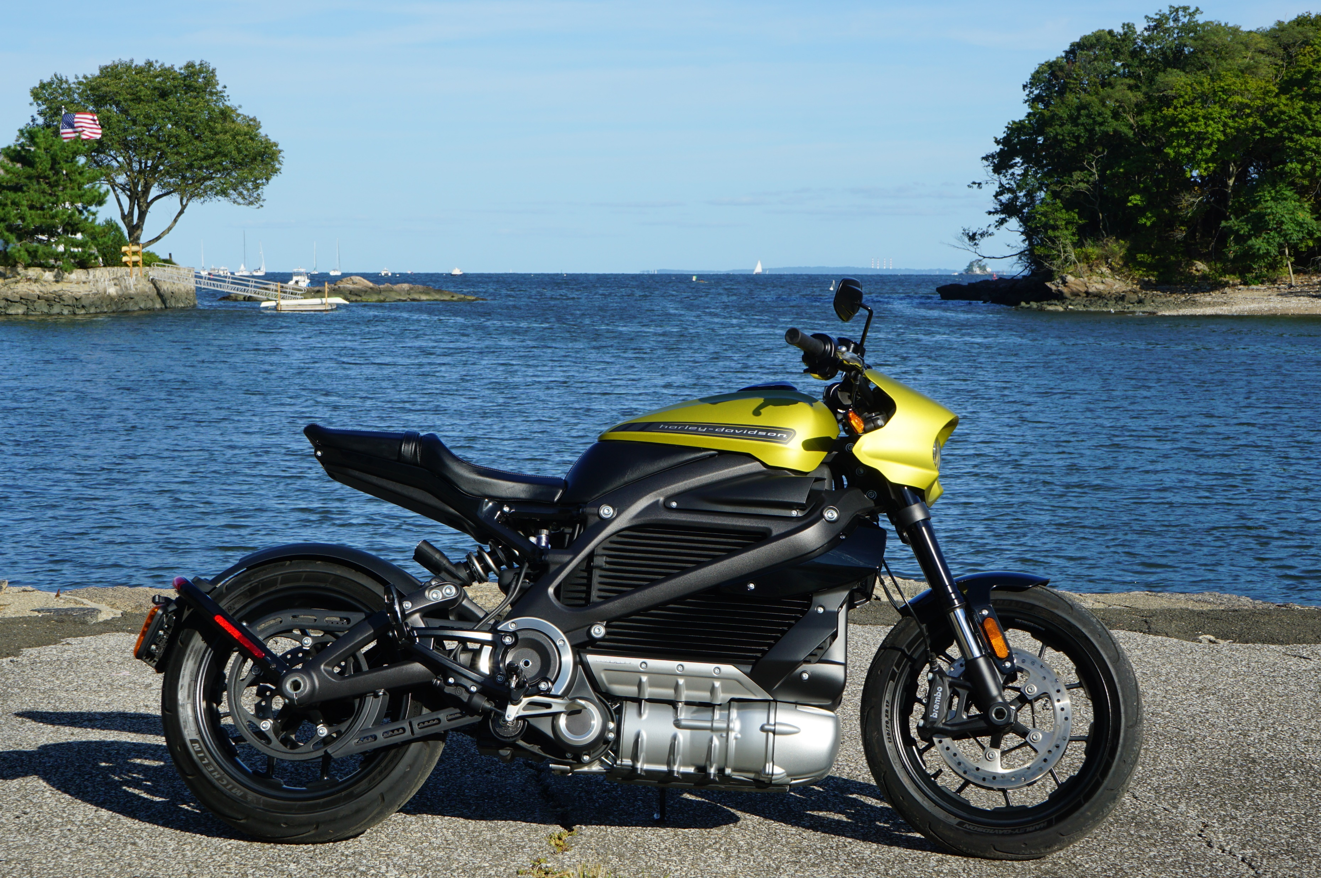
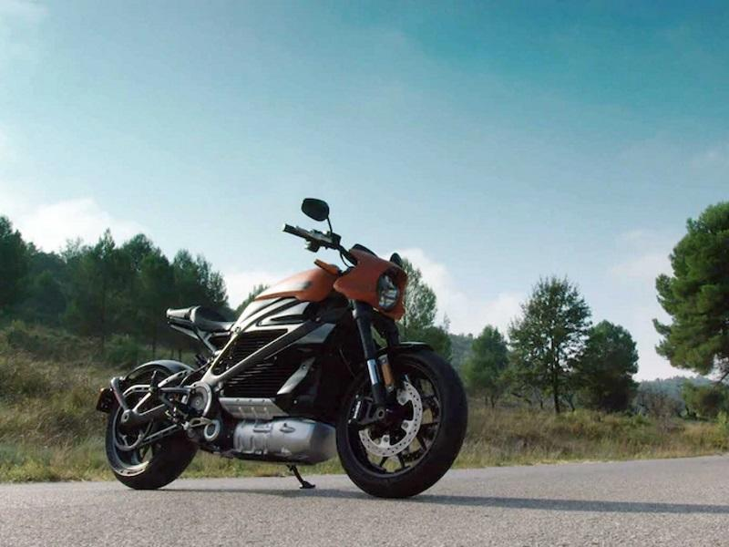
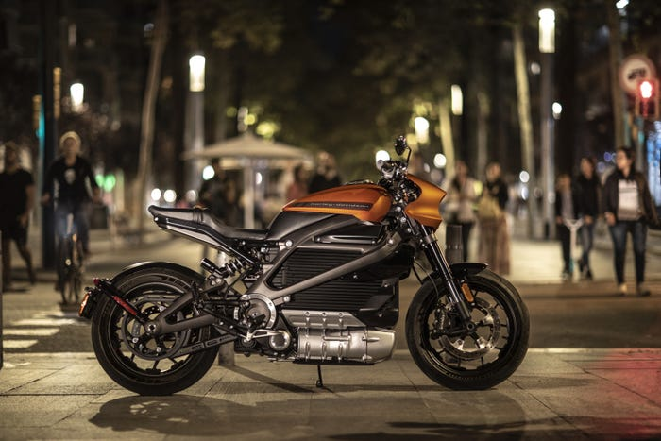
Image Courtesy of https://techcrunch.com/2021/05/10/harley-davidson-spins-out-livewire-into-a-standalone-electric-motorcycle-brand/amp/
Image Courtesy of https://www.bartelsharley.com/harley-livewire-for-sale-marina-del-ray-ca--xallinventory?customSearch=livewire
Image Courtesy of https://www.businessinsider.com/electric-motorcycles-market-harley-livewire-zero-photos-specs-2020-3?amp
Celebrate Earth Day everyday on a Harley Davidson Livewire. The Harley Davidson Livewire is built with the latest technology available. At Harley Davidson, we developed the Livewire with you in mind. The Livewire is a fully electric motorcycle that offers an environmentally friendly alternative to traditional motorcycles. With the Harley Davidson Livewire, you'll get 165 mpc - and it only takes 40 minutes to fully charge. And the best part is, the Livewire isn't only friendly to the environment, but with a $21,999 MSRP, it's also friendly to your wallet. This Harley Davidson ain't your dad's motorcycle. #notyourdad'smotorcycle #harleydavidsonmotorcycles #cleanerearth #environmentallyfriendly
Notes:
Celebrate Earth Day everyday on a Harley Davidson Livewire. The Harley Davidson Livewire is built with the latest technology available. At Harley Davidson, we developed the Livewire with you in mind. The Livewire is a fully electric motorcycle that offers an environmentally friendly alternative to traditional motorcycles. With the Harley Davidson Livewire, you'll get 165 mpc - and it only takes 40 minutes to fully charge. And the best part is, the Livewire isn't only friendly to the environment, but with a $21,999 MSRP, it's also friendly to your wallet. This Harley Davidson ain't your dad's motorcycle. #notyourdad'smotorcycle #harleydavidsonmotorcycles #cleanerearth #environmentallyfriendly

Slide 14
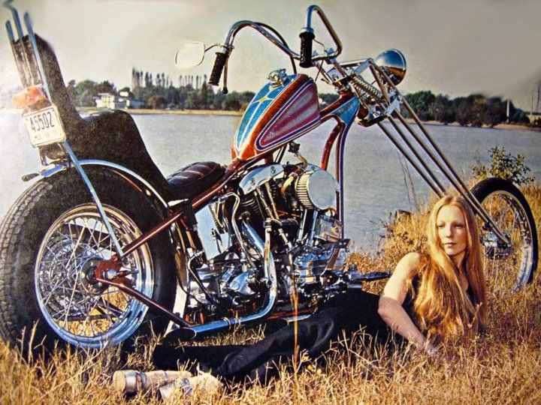
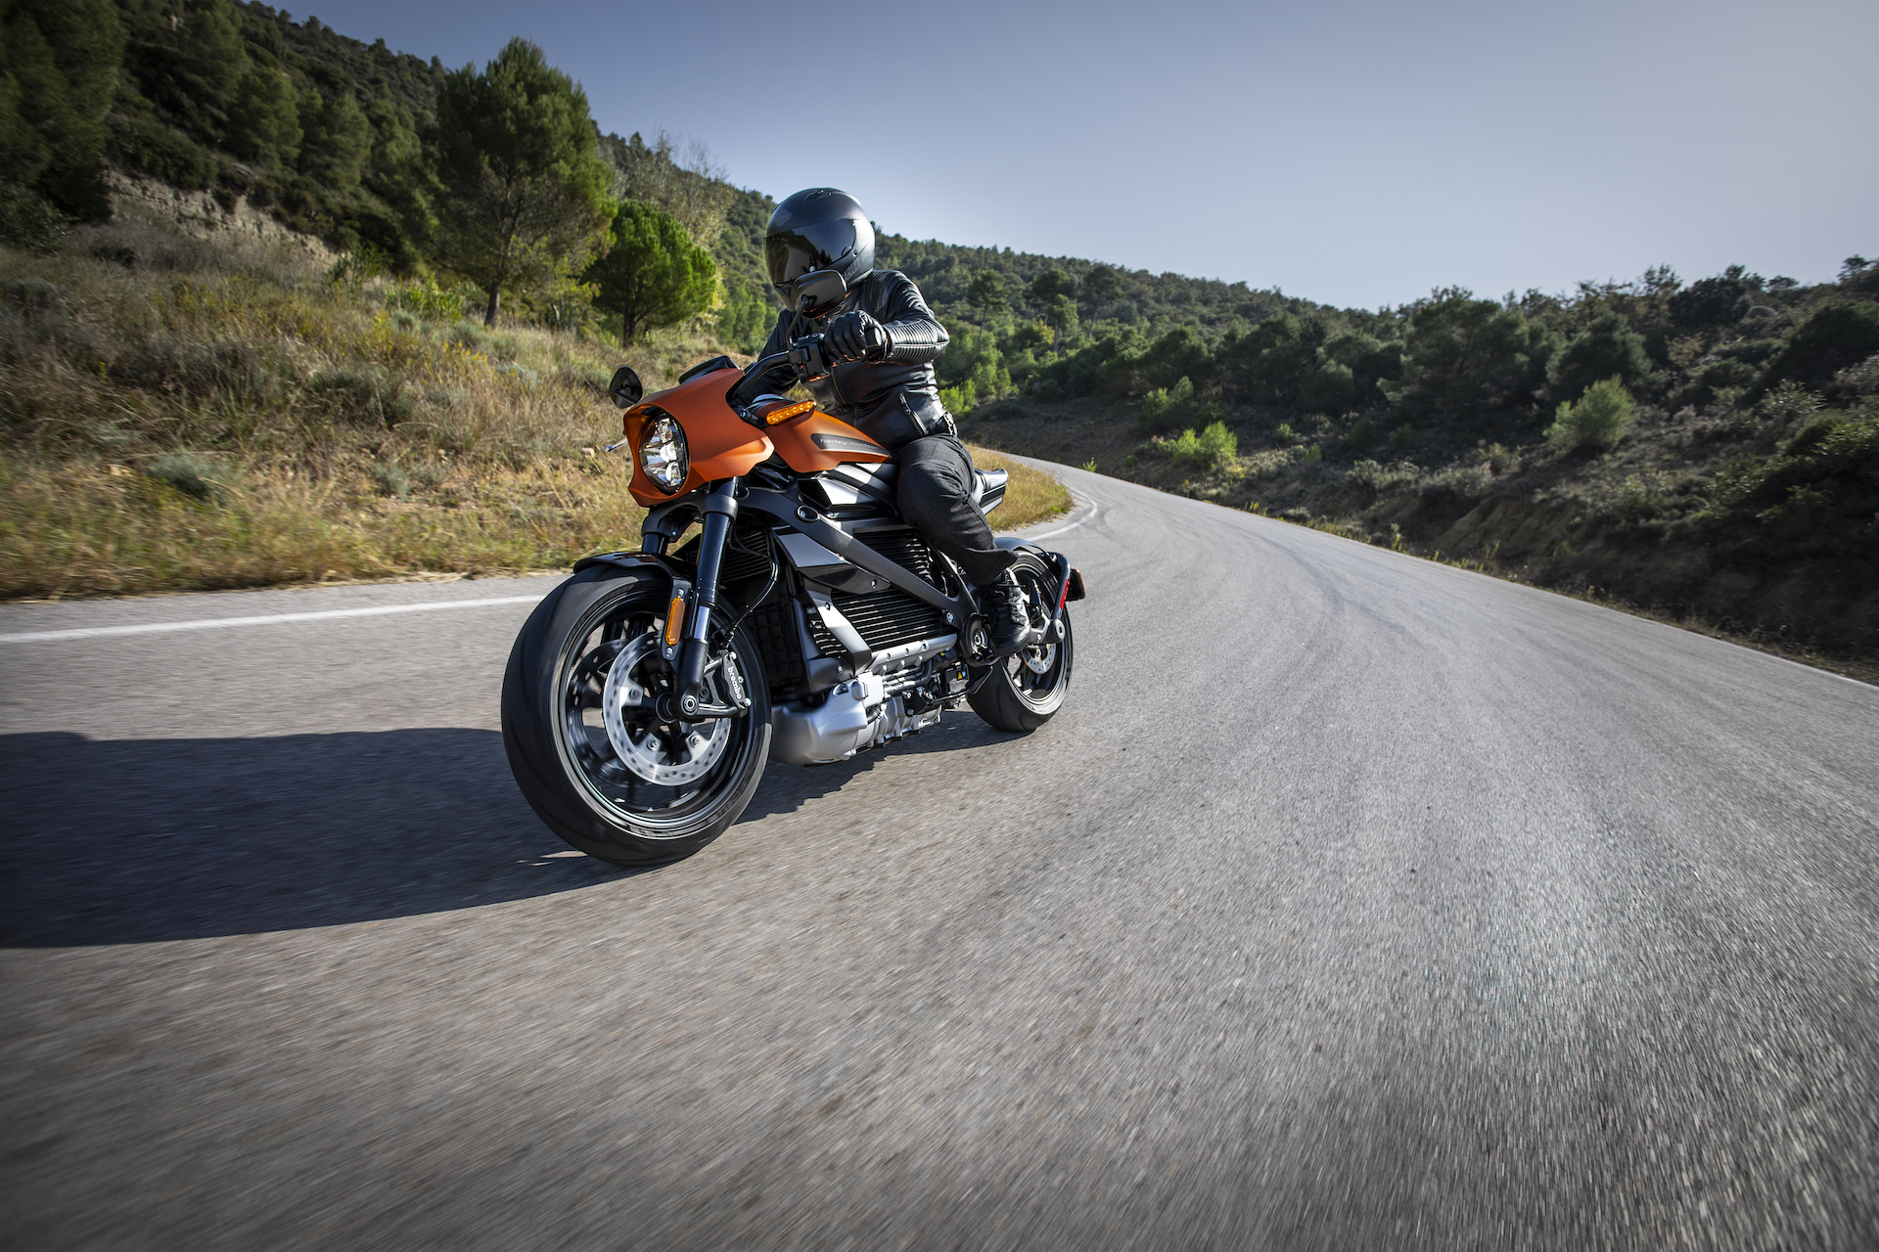
Welcome the future of motorcycles - The Harley Davidson Livewire. Fully electric and environmentally friendly, the Livewire is the next generation of motorcycles, built for the next generation of riders. #Thisain'tyourdad'sHarleyDavidson! Recharge your batteries - get out and let the wind in your hair. Harley Davidson Motorcycles gives you the opportunity to experience freedom! With a wide variety of options to choose from, visit our website here to find the Harley Davidson motorcycle that you have always wished for. Yo #Forgetaboutlifeandstartliving #allchargedup
Image Courtesy of https://www.renderhub.com/francozero/70s-old-school-harley-davidson-chopper
Image Courtesy of https://www.greencarreports.com/news/1124098_harley-davidson-livewire-electric-motorcycle-gets

Slide 15
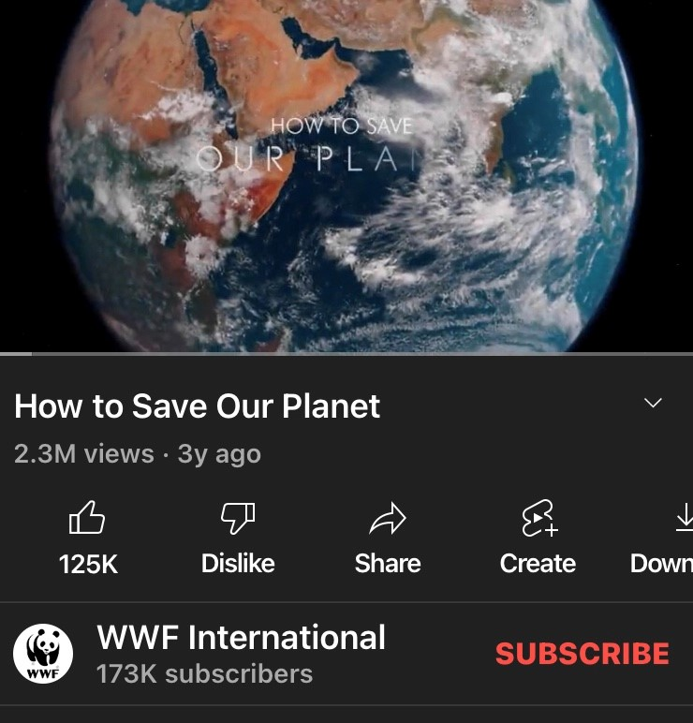
Save the Planet Riding a Harley Davidson Livewire helps reduce fuel consumption, thereby helping to reduce overall carbon emissions. The Harley Davidson Livewire allows those who ride it to have small part in the very big job of protecting the environment. The next time you ask what you can do to help environment, think about how riding a Livewire might be the answer you're looking for. Watch this video to learn more! #savetheplanet #livewire
Courtesy of https://youtu.be/0Puv0Pss33M
Notes:
Riding a Harley Davidson Livewire helps reduce fuel consumption, thereby helping to reduce overall carbon emissions. The Harley Davidson Livewire allows those who ride it to have small part in the very big job of protecting the environment. The next you ask what you can do to help environment, think about how riding a Livewire might be the answer you're looking for. Watch this video to learn more! #savetheplanet #livewire

Slide 16
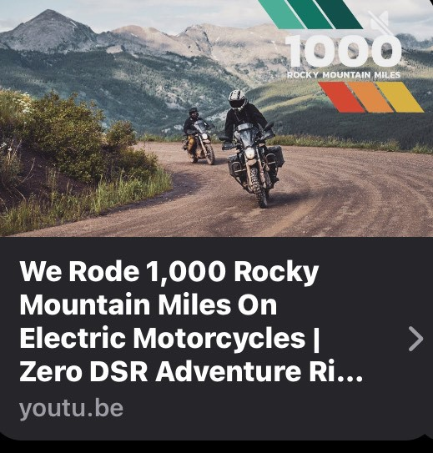
Across the Great Divide
Take a tour way up in the cool Rocky Mountains with an electric cycle rider. #electriccyclerider #livewire #harleydavidson
Couryesy of https://youtu.be/K0GsTP3KC_U
Notes:
Take a tour way up in the cool Rocky Mountains with an electric cycle rider. #electriccyclerider #livewire #harleydavidson

Slide 17
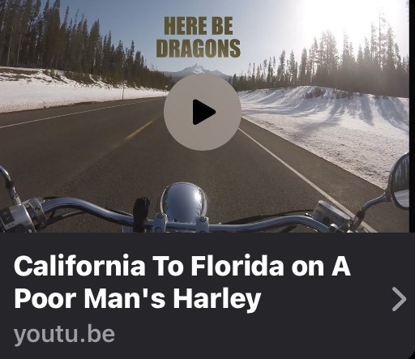
From Sea to Shining Sea There aren't many things that compare to the pure, natural beauty of the United States! Click here to see firsthand, some of the beauty the country has to offer. #Livewire #Harleydavidson
Courtesy of https://youtu.be/Wlz5WZZi9qA
Notes:
There aren't many things that compare to the pure, natural beauty of the United States! Click here to see firsthand, some of the beauty the country has to offer. #Livewire #Harleydavidson

Slide 18
Concludi ng
thoughts

Slide 19
Understand Digital Media Consumption Habits • Facebook: 81 percent • YouTube: 93 percent Understanding Target Audience
Values • Messaging aligned with target audience values
Notes:
Having identified the specific target audience - men and women aged 25 to 35 - and understanding their values and principles, as well as how they communicate with regards to their digital media consumption has made developing a strategic marketing campaign aimed specifically at that target audience possible. The selected channels of communication, Facebook and YouTube, have been strategically selected due to the platforms' wide use among that target audience. The Pew Research Center indicates that the number of Facebook users among the target audience age range stands at 81 percent and the number of YouTube users in the target audience age range stands at 93 percent, respectively (pewresearchcenter.org, 2022). The message attempts to align content with target audience values. By expressing an understanding of concerns that tend to be highly valued by the target audience, the campaign demonstrates Harley Davidson's interest in the target audience and their values. By creating messages sensitive and relevant to target audience values and conveying them through digital media platforms commonly used by the target audience, Harley Davidson Motorcycles hopes that the campaign will attract a new generation of Harley Davidson motorcycle riders.

Slide 20


Slide 21
References
Alamalhodaei, A. (2021, May 11). Harley-Davidson spins out Livewire into a standalone electric motorcycle brand. TechCrunch. Retrieved April 15, 2022, from https://techcrunch.com/2021/05/10/harley-davidson-spins-out-livewire-into-a-standalone-electric-motorcycle-brand/amp/
Anonymous Biker USA . (2020, September 1). Riding the Poconos! Pennsylvania's best kept secret for motorcycles!YouTube. Retrieved April 15, 2022, from https://youtu.be/Wlz5WZZi9qA
Carpenter, N. (2019, July 24). How to delete Facebook data forever. Time. Retrieved April 15, 2022, from https://time.com/5633726/how-to-delete-facebook-data/
Dealer Spike. (2022). Harley Davidson® livewire™ motorcycle sales | ca. Bartels Harley. Retrieved April 15, 2022, from https://www.bartelsharley.com/harley-livewire-for-sale-marina-del-ray-ca--xallinventory?customSearch=livewire
Electric Cycle Rider . (2021, November 14). We rode 1,000 Rocky Mountain Miles on electric motorcycles: Zero DSR adventure ride. YouTube. Retrieved April 15, 2022, from https://youtu.be/K0GsTP3KC_U
Evarts, E. C. (2019, July 15). Harley-Davidson gives Livewire owners free charging with Electrify America. Green Car Reports. Retrieved April 15, 2022, from https://www.greencarreports.com/news/1123991_harley-davidson-gives-livewire-owners-free-charging-with-electrify-america
Evarts, E. C. (2019, July 18). Harley-Davidson Livewire Electric Motorcycle Range, Performance Specs revealed. Green Car Reports. Retrieved April 15, 2022, from https://www.greencarreports.com/news/1124098_harley-davidson-livewire-electric-motorcycle-gets

Slide 22
Frank, A. P. (2018, March 23). Timeline of Harley-Davidson history. Motorcycle Cruiser. Retrieved April 15, 2022, from https://www.motorcyclecruiser.com/history-harley-davidson/
Hughes, M. (2019, September 13). Everything you need to know about charging the Harley davidson livewire. ChargePoint. Retrieved April 15, 2022, from https://www.chargepoint.com/blog/everything-you-need-know-about-charging-harley-davidson-livewire
Levin, T. (2020, March 17). Harley-Davidson's EV motorcycle flopped, but there are other options. Business Insider. Retrieved April 15, 2022, from https://www.businessinsider.com/electric-motorcycles-market-harley-livewire-zero-photos-specs-2020-3?amp
Neeves , M., & Fitz-Gibbons, M. (2020, August 28). Harley-Davidson Livewire (2019 - On) review. MCN. Retrieved April 2, 2022, from https://www.motorcyclenews.com/bike-reviews/harley-davidson/livewire/2019/
Robison, J. (2021, November 20). Millennials worry about the environment -- should your company? Gallup.com. Retrieved March 26, 2022, from https://www.gallup.com/workplace/257786/millennials-worry-environment-company.aspx
Smith, K. (2020, February 21). 57 fascinating and incredible YouTube statistics. Brandwatch. Retrieved April 15, 2022, from
https://www.brandwatch.com/blog/youtube-stats/
Steppenwolf . (2016, August 9). Steppenwolf - born to be wild (easy rider) (1969). YouTube. Retrieved April 2, 2022, from https://youtu.be/egMWlD3fLJ8
Unknown . (2015, September 29). Old school chopper: Old school chopper, Chopper Motorcycle, Harley Davidson. Pinterest. Retrieved April 15, 2022, from https://www.pinterest.com/pin/103793966389294821/

Slide 23
Unknown. (2019). 70s Sportster Chopper. Retrieved April 15, 2022, from https://www.tropicar-guadeloupe.fr/products.aspx?cname=70s%2Bsportster%2Bchopper&cid=5&xi=3&xc=25&pr=73.99
Unknown. (2022). Harley Davidson logo. Nomad Logic Inc. 2000-2022. Retrieved April 15, 2022, from https://www.nomadlogic.com/clients/harley-davidson-logo/
Unknown. (2022). PNG images: Harley Davidson. Harley Davidson PNG images free download. Retrieved April 15, 2022, from https://pngimg.com/images/cars/harley_davidson
Unknown . (2022, April 1). The official site. Earth Day. Retrieved April 2, 2022, from https://www.earthday.org/
Unknown. (2022, January 11). Demographics of social media users and adoption in the United States. Pew Research Center: Internet, Science & Tech. Retrieved April 9, 2022, from https://www.pewresearch.org/internet/fact-sheet/social-media/
Unknown. (2022). Meet the Livewire One. LiveWire.com. Retrieved April 9, 2022, from https://www.livewire.com/?utm_source=google&utm_medium=cpc&utm_campaign=Electric_LiveWire_Brand_P&utm_term=harley+electric+livewire&gclid=Cj0KCQjw6J-SBhCrARIsAH0yMZgqWVT36Umkl6vOJEY_Cr0Moar8SLkB316hAXCIGfewnVizd4bjgPUaAh_cEALw_wcB&gclsrc=aw.ds
WWF International . (2019, April 5). How to save our planet. YouTube. Retrieved April 15, 2022, from https://youtu.be/0Puv0Pss33M

